Slide 1

Software Architecture
SSE USTC Qing Ding
dingqing@ustc.edu.cn
http://staff.ustc.edu.cn/~dingqing

Slide 2

Pattern and Style II

Slide 3
Outline
Network-Centred Style
Remote Invocation Architectures
GUI Architectures (Interactive )
Adaptable Architectures
Transaction-Processing
Others
Heterogeneous Architectures

Slide 4
Network-Centred Style
Focus on communication.

Slide 5
Client-server and other Distributed Architectural Patterns
  At least one component has the role of server:
    waiting for and then handling connections.
  At least one component that has the role of client, initiating connections to obtain some service.
  Three-tier model for web-based client-sever applications:
    Server ‘in the middle’
      server to client (web-based or not; likely communicating via the Internet)
      client to a database server (usually / often via an intranet)

Slide 6
Client-Server Style
Components are clients and servers
Servers do not know number or identities of clients
Clients know server’s identity
Connectors are RPC-based network interaction protocols

Slide 7
Client-Server
Basic concept:
The client uses a service
The server provides a service The service can be any resource
E.g. data, file, CPU, display device Typically connected via a network Clients are independent from each other

Slide 8
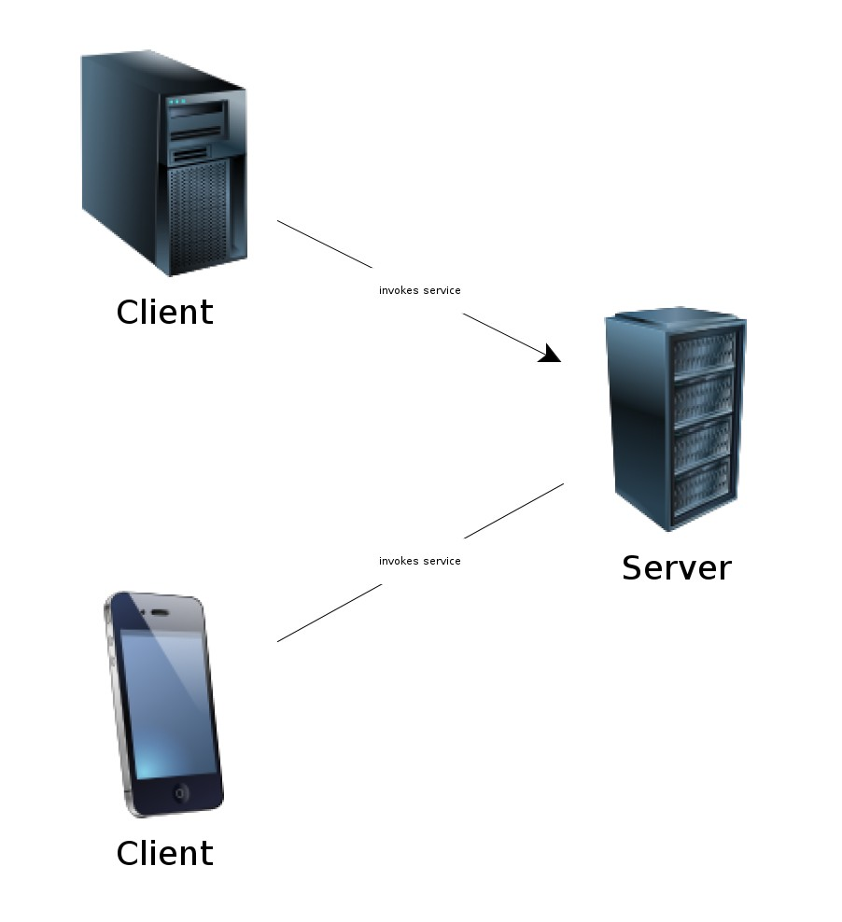
Client-Server

Slide 9
Client-Server
The server provides an abstract service
The implementation of the server decides how to fulfil the request Abstraction of programming language, operating system
⇒ loose coupling between client and server The location of the server is transparent
Sometimes the client also might become the server (and vice versa)
⇒ increases the coupling

Slide 10
Client-Server
Separation of concerns (SoC)
Functionality is clearly split into separate components
Also a motivation for the layered architecture style, where each layer is responsible for its own abstraction
Aspect oriented programming tries to separate cross-cutting concerns into separate modules
Supports independent evolvability
Achieved, if the communication between client and server is well designed

Slide 11
Client-Server
Client-server pattern is used by other architectural styles
It can be used to realise a shared repository
E.g. for the data-centric repository pattern
E.g. for filters which operate on a single shared data structure

Slide 12
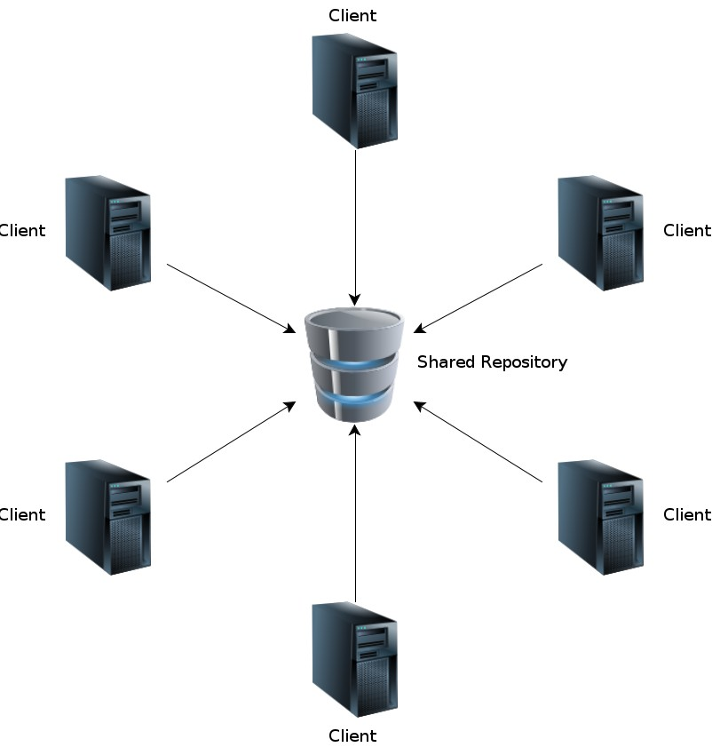
Client-Server - Shared Repository

Slide 13
Client-Server
Two basic types of topology of the server Single, centralised server or
Multiple, distributed servers
Centralised servers are easier to administer (install, deploy updates, maintain, monitor, ...)
Distributed servers scale better, but could introduce complexity (e.g. require two-phase commits)

Slide 14
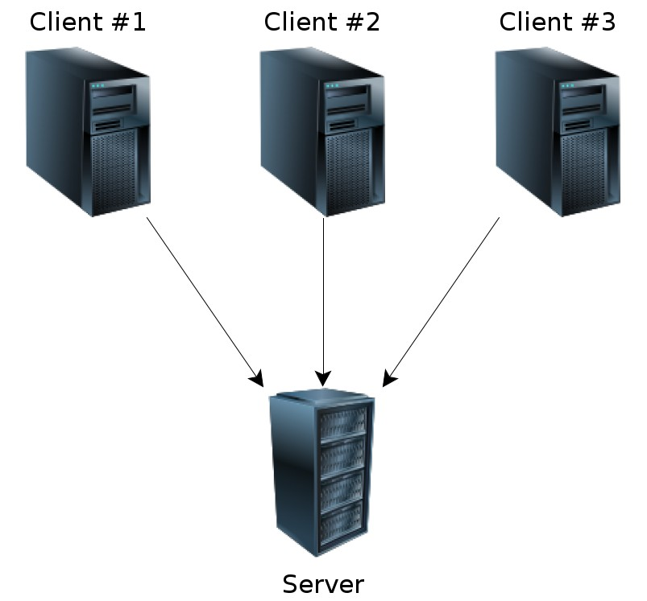
Client-Server - Centralised

Slide 15
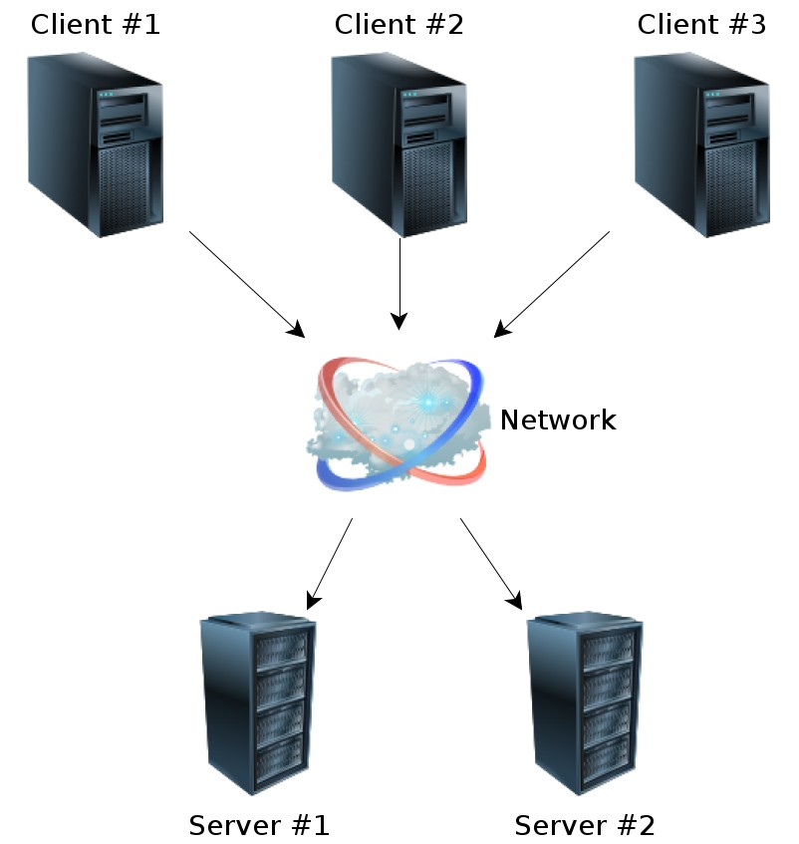
Client-Server - Distributed

Slide 16
An Example Of A Distributed System
Client1:
<<communication>>
look up addresses
<<communication>>
exchange messages
<<communication>>
Server:
exchange messages
Client2:
<<communication>>
<<communication>>
look up addresses
exchange messages
Client3:

Slide 17
Client-Server - Scalability
Two basic types of scaling:
Vertically, by increasing the computing power of a single machine (scale up)
Horizontally, by adding more machines (scale out)
Note: scaling strategies are not specific to client-server architectures

Slide 18
Client-Server - Scalability
Scaling vertically is often the only option
Especially if the system has not been designed from the ground up to allow distributed processing
Scaling vertically is made easier in a virtual environment (virtual machines instead of physical)
Because the system could be transferred to a more powerful machine, without the system knowing

Slide 19
Client-Server - Scalability
Scaling horizontally should provide a high upper limit for scalability
Needs support from the system, not every system allows being distributed
Might lead to a high communication overhead due to synchronisation between the nodes

Slide 20
Client-Server - Scalability
Distributed servers need to be specifically designed to allow scaling horizontally
Will be typically more effort to develop Upgrading to a bigger machine might be cheaper
Which strategy (scale up or scale out) is more suitable, depends on the actual system.

Slide 21
Client-Server
Stateful vs. stateless
  If the client-server communication is stateful, the server keeps track of the application state
  Typically provides a handle or a session id
  The client then may manipulate the state on the server, e.g.
    Open file (returns file handle) Append line
    Close file
  Easier for the clients, as they not need to manage the state ⇒ needed if coupled with thin clients
. . . .
. . .
<number> / 63

Slide 22
Client-Server
If the client-server communication is stateless, the client is responsible to keep track of the application state
The server does not need to store or manage session specific data ⇒
typically coupled with rich clients
Therefore the scalability of stateless servers are generally better than stateful

Slide 23
Client-Server
Cloud Computing
  The server is no longer in the organisations network, but somewhere in the Internet
  Example: cloud services by Salesforce, Google, Microsoft
  Scalability, security, reliability is expected to be handled by a specialised team
  Loss of control, legal issues (data is exported to another country) Needs a working Internet connection

Slide 24
Client-Server - Advantages
Conceptually simple
Clear separation of responsibilities, eases evolvability, helps testability
Good scalability (especially, if stateless)
  Excellent scalability (if server can be scaled out)
Good for security, as data can be held at the server with restricted access

Slide 25
Client-Server - Disadvantages
Risk of bad usability/performance, if the communication between client and server is slow, or has a high latency
Need to develop/agree on a protocol between client and server
For stateful, centralised servers scalability is limited
Integrability into existing systems might not be possible (e.g. if the communication is not possible, or not allowed)

Slide 26
Other Distributed Client-server Architectural Patterns
  Peer-to-Peer pattern. A system where:
    various software components distributed over several hosts.
    Hosts: both clients and servers (to each other)
    Any two components can set up a communications channel through which communications is accomplished.
  Variation:
    Sometimes peers need to be able to find each other;
    May need a server containing location information

Slide 27
Peer-to-Peer Style
State and behavior are distributed among peers which can act as either clients or servers.
Peers: independent components, having their own state and control thread.
Connectors: Network protocols, often custom.
Data Elements: Network messages

Slide 28
Peer to peer
Separation between client and server is removed
Each client is a server at the same time, called peer
The goal is to distribute the processing or data among many peers
No central administration or coordination

Slide 29
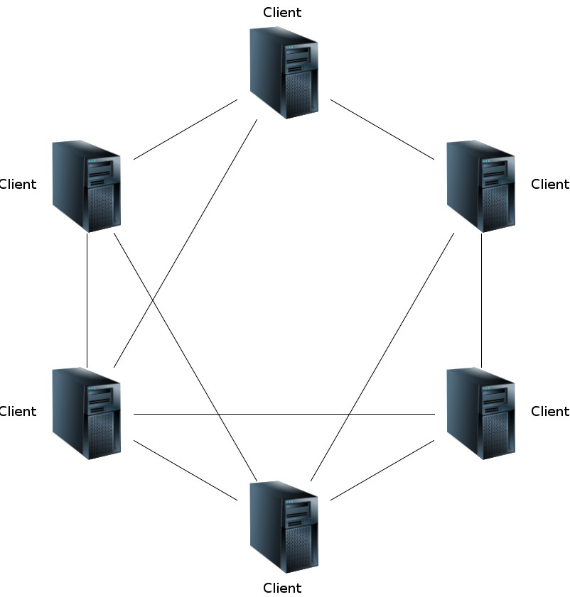
Peer to peer

Slide 30
Peer to peer
Each peer provides services and consumes services
Communication might occurs between all peers
Number of peers is dynamic
Each peer has to know how to access other peers (discover, search, join)

Slide 31
Peer to peer
Once a peer is initialised, it needs to be come part of the network
A bootstrapping mechanism is needed:
  For example via a broadcast message
  For example a public list of network addresses

Slide 32
Peer to peer - centralised P2P
Centralised peer to peer
Some aspects are centralised
For example, a central component keeps track of the available peers

Slide 33
Peer to peer - hybrid P2P
Hybrid peer to peer
Not all peers are equal, some have additional responsibilities
They are called supernodes
Example: Skype uses a peer-to-peer protocol, but also uses supernodes and a central login servers

Slide 34
Peer to peer - Advantages
Typically, excellent scalability, as the computation can be distributed
Good for reliability, as data can be replicated over multiple peers
No single point of failure

Slide 35
Peer to peer - Disadvantages
Quality of service is not deterministic, cannot be guaranteed
E.g. high latency
Very complex, hard to maintain and to test

Slide 36
How Does The Client-server Architectural Pattern Subscribe To Principles Of Good Architectural Design?
  1. Divide and conquer: Dividing the system into client and server processes is a strong way to divide the system.
    ➔ Each can be separately developed.
  2. Increase cohesion: Server can each provide cohesive services to clients.
  3. Reduce coupling: There is usually only one communication channel exchanging simple messages.
  4. Increase abstraction: Separate distributed components are often good abstractions. What does this sentence mean to you? Abstractions??
  6. Increase reuse: It is often possible to find suitable frameworks on which to build good distributed systems. Sample architectures already exist. However, client-server systems are often very application specific.

Slide 37
Remote Invocation Architectures
Focus on the remote invocation (via network).

Slide 38
Remote invocation and service architectures
Remote invocation architectures involve distributed processing components
Typically, a client component invokes a method (function) on a remote component

Slide 39
Remote invocation and service architectures
Advantages: increased performance through distributed computation
Only if network is reliable and fast and the communication overhead is manageable
Disadvantages: often, tightly coupling of components
Managing of addressability (recollect unique identity of objects) increases communication overhead

Slide 40
Remote invocation and service architectures
Service architectures introduce a special component where services are registered
Any component interested in a service asks that component for the address of the service
It tries to solve the addressability problem
If communication protocols are standardized then services can be integrated on-the-fly

Slide 41
Remote invocation and service architectures
Use Web protocols for communication
However, the addressability is still not managed because you have to know how to address objects in a remote service
Web services are in essence only remote procedure calls using Web protocols
Same advantages and disadvantages apply

Slide 42
Broker
Separate communication from the application functionality Support for distributed systems
The broker hides the communication from the components of the system
The broker coordinates the communication
A broker can be used to transparently change a non-distributed system into a distributed one
For example: The client interacts with a remote object via a broker
Note: Similar to the proxy design pattern

Slide 43
The Broker Architectural Pattern
  Here, we transparently distribute aspects of the software system to different nodes
    Objects call method’s other objects w/o knowing object is remotely located.
    Client does not ‘care’ where the remote object is.
    CORBA: well-known open standard allowing you to build this kind of architecture.
      (Common Object Request Broker Architecture)
      (Microsoft has its own architecture: COM, DCOM (old))
      ‘Proxy design pattern’ can be used such that a proxy object calls the broker, which determines where the desired object is located.

Slide 44

Example of a Broker system
Very popular design pattern. Simple and very effective.
Note that all these architectural patterns are illustrated using ‘components.’

Slide 45
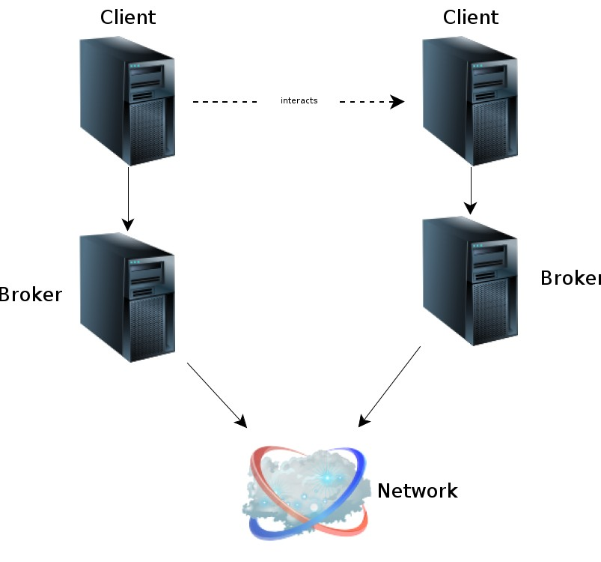
Broker

Slide 46
Broker - Tasks of a broker
The task of the broker
Find the appropriate server/service Forward request to the servers, and
Report the result (or error message/exception) back to the client
The communication is abstracted away from the client

Slide 47
Broker - Relationship to other patterns
The broker pattern has relationships with other patterns
E.g. the broker can be implemented as separate layer
E.g. the broker uses a client/server infrastructure

Slide 48
Broker - Advantages
Decoupling of components (the networking aspect) Helps flexability, maintainability and evolvability
Allows a system to be distributed, even if it has not been designed for this in the first place

Slide 49
Broker - Disadvantages
Network communication might introduce new types of errors
Due to network latencies and limited bandwidth the behaviour might change

Slide 50
Broker Architecture And How This Architectural Design Pattern Subscribes To Design Principles
  1. Divide and conquer: The remote objects can be independently designed.
  5. Increase reusability: It is usually possible to design the remote objects so that other systems can use them too. We see this all the time on the Internet.
  7. Design for flexibility: The brokers can be updated as required, or the proxy can communicate with a different remote object.
  9. Design for portability: You can write clients for new platforms while still accessing brokers and remote objects on other platforms.
  11. Design defensively: You can provide careful assertion checking in the remote objects.
  Note that there are fewer design principles satisfied. Does NOT make this pattern inferior! (coherence; coupling; obsolescence, more…)

Slide 51
Interpreter Style
Interpreter parses and executes input commands, updating the state maintained by the interpreter
  Components: Command interpreter, program/interpreter state, user interface.
  Connectors: Typically very closely bound with direct procedure calls and shared state.
  Highly dynamic behavior possible, where the set of commands is dynamically modified.
  System architecture may remain constant while new capabilities are created based upon existing primitives.
  Superb for end-user programmability; supports dynamically changing set of capabilities
  Lisp and Scheme

Slide 52
Interceptor - Overview
Motivation: Separate functionality into a separate components
Allow integration of additional services without changing the core components
Interface provided by a component, which allows another component to register itself
And be invoked at specific events
Open-closed design principle (open for extension, but closed for modifications)
Used to address cross-cutting concerns

Slide 53
Interceptor - Example
Example: Logging
System consists of two components: a client and a server
Each component provides a callback interface when some event occurs
A logging components registers itself at every component
The logging components store the log into a shared repository

Slide 54
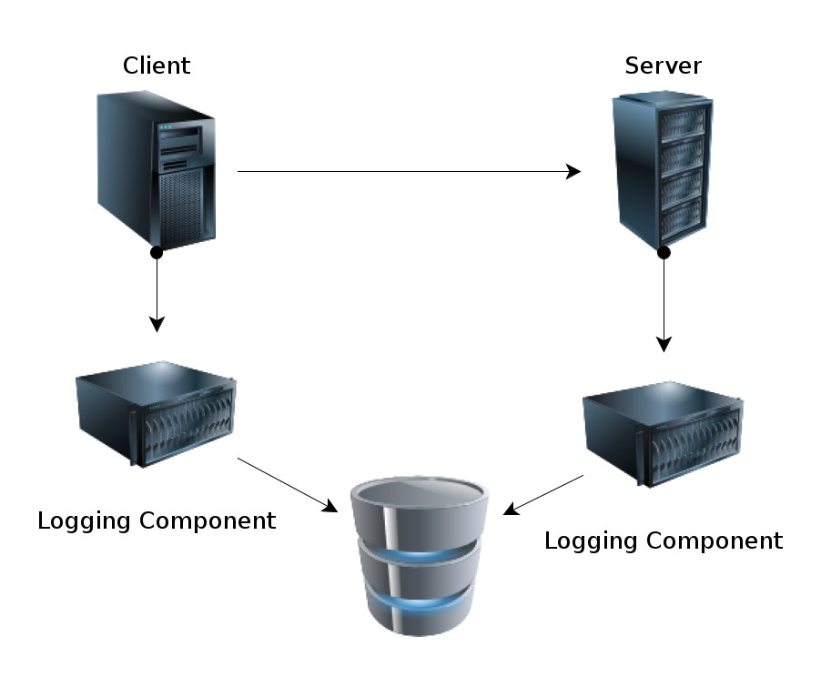
Interceptor - Example

Slide 55
Interceptor - Advantages
Interceptor components can be reused (reusability)
Excellent flexability
Clear separation of concerns, loose coupling ⇒ maintainability, evolvability

Slide 56
Interceptor - disadvantages
Can get quite complex quickly
Potential cascading callbacks, endless loops
Sometimes event non-deterministic
Core components need to provide the callback interface
May lead to bad testability

Slide 57
GUI Architectures
Focus on user interaction.

Slide 58
Model View Controller (MVC)
Motivation: reusability and separation of concerns Three roles: model, view & controller
Model: encapsulates the behaviour and data of the application domain
View: renders the model for presentation
Controller: Reacts on user input, modifies the model and dispatches to the view
Both, controller and view, depend on the model Controller and view are part of the UI

Slide 59
Model View Controller (MVC)
MVC is often used for web applications (but not exclusively) Many existing frameworks:
AngularJS, JavaServer Faces (JSF), Struts, CakePHP, Django, Ruby on Rails, ...

Slide 60
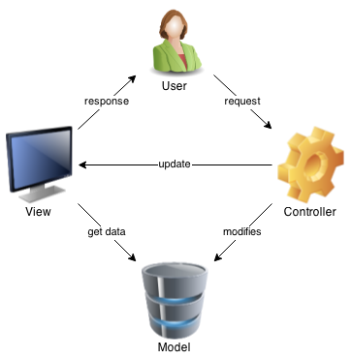
Model View Controller (MVC)

Slide 61
MVC - Model
Model
Encapsulates the application state
Response to state queries
Exposes application functionality
Notify view of changes (optionally)
Note: Notification only necessary, if the model and view realise an observer pattern

Slide 62
MVC - View
View
Renders the model
Requests updates from model
Prepares the user interface for the controller
Usually multiple views

Slide 63
MVC - Controller
Controller
Manipulates the model
Triggers application behaviour
Selects view for response (optionally)

Slide 64
MVC - Relationships
The model-view-controller pattern does not replace a n-tier architecture
Model is part of the n-tier pattern and the MVC pattern
The model communicates with lower abstraction layers (e.g. data access layer)
The model might use a notification pattern to inform the view of changes
The lesser known presentation-abstraction-control pattern is similar to MVC

Slide 65
MVC - Advantages
Separation of concerns, helps reusability
Multiple user interfaces without changes to the model, e.g. mobile and Web
Helps configurability (as interface changes are easier, with less expected side effects than changes to the application logic)

Slide 66
MVC - Disadvantages
Increases the complexity by additional components Not all systems are applicable to MVC pattern
If updates to the view are based on notifications, it might be hard to find errors
In these cases, it is hard to ensure a good usability (no control when an update happens)

Slide 67
PAC
Presentation-­‐Abstraction-­‐Control
  It is an interaction-­‐oriented software architecture, and is somewhat similar to model–view–controller (MVC) in that it separates an interactive system into three types of components responsible for speciOic aspects of the application's functionality.
  The abstraction component retrieves and processes the data
  The presentation component formats the visual and audio presentation of data, and
  The control component handles things such as the Olow of control and communication between the other two components .

Slide 68
PAC
Difference between MVC and PAC
  The Controllers of MVC focus on the input from and the output to Views,
  While the Controllers of PAC focus on the communication and coordination among agents and the ones inside agents.
  PAC divides the systems into layered and loose coupled agents,
  While MVC focuses on the separation of Models and Views, in which there are no layered agents.

Slide 69
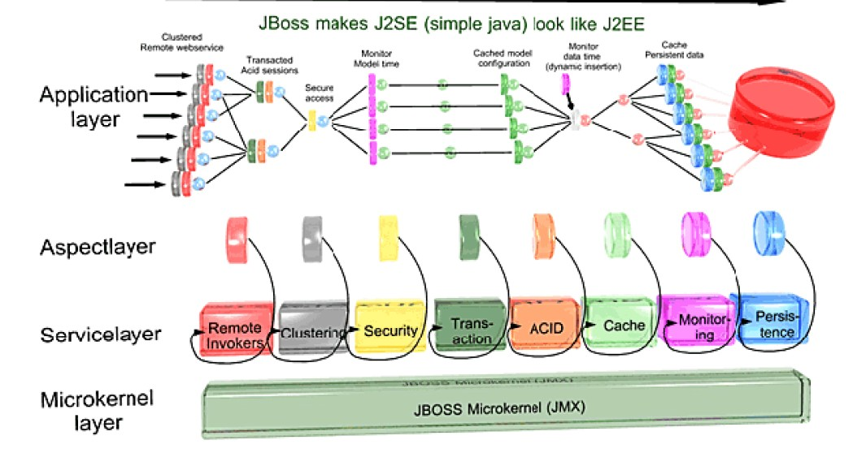
Adaptive Styles – Micro Kernel
Micro Kernel
– is the near-­‐minimum amount of software that can boot up the necessary services of a software system.

Slide 70
Adaptive Styles – Reflection
Reflection
  Has meta information about other elements of a system.
  The meta information is used as the basic element to communicate with other element.
  The elements described by meta information are base elements.
  The base elements have many common attributes, onto which the uniOied process is applied.

Slide 71
Adaptive Styles – Reflection
OperatorsEncapsulator
+genericOperation1()
+genericOperation2()
+genericOperationN()
 |  | IBaseElement
Client
 |  | +operation1() +operation2() +operationN()
Descriptor
Client
IBaseElement
1
1
-desc1
-desc2
-descN
BaseElement1 |  |  |  | BaseElementN
-attr1 -attr2 -attrN |  |  |  | -attr1 -attr2 -attrN
+operation1() +operation2() +operationN() |  |  |  | +operation1() +operation2() +operationN()
+...()
BaseElement1 |  |  |  | BaseElementN
-attr1 -attr2 -attrN |  |  |  | -attr1 -attr2 -attrN
+...() |  |  |  | +...()
（a）普通继承-实现架构
（b）反射架构

Slide 72
Adaptive Styles – Reflection
Advantage
  It is quite easy to add new elements or attributes
  It supports various modification
Disadvantage
  Low performance
  Complex structure of classes

Slide 73
Transaction-Processing

Slide 74
Transaction-Processing Architectural Pattern
A process reads a series of inputs one by one.
  Each input describes a transaction – a command that typically (for example) might change some data stored by the system
  Normally transactions come in one-by-one. generally atomic.
    Do this, then that, then another thing. Add, Change, Delete…
  A transaction dispatcher briefly processes a transaction and ‘hands’ that transaction to a specific transaction handler designed to specifically ‘handle’ that kind of transaction.
  The transaction handler is specifically designed and implemented to handle ‘a’ specific type of transaction.

Slide 75
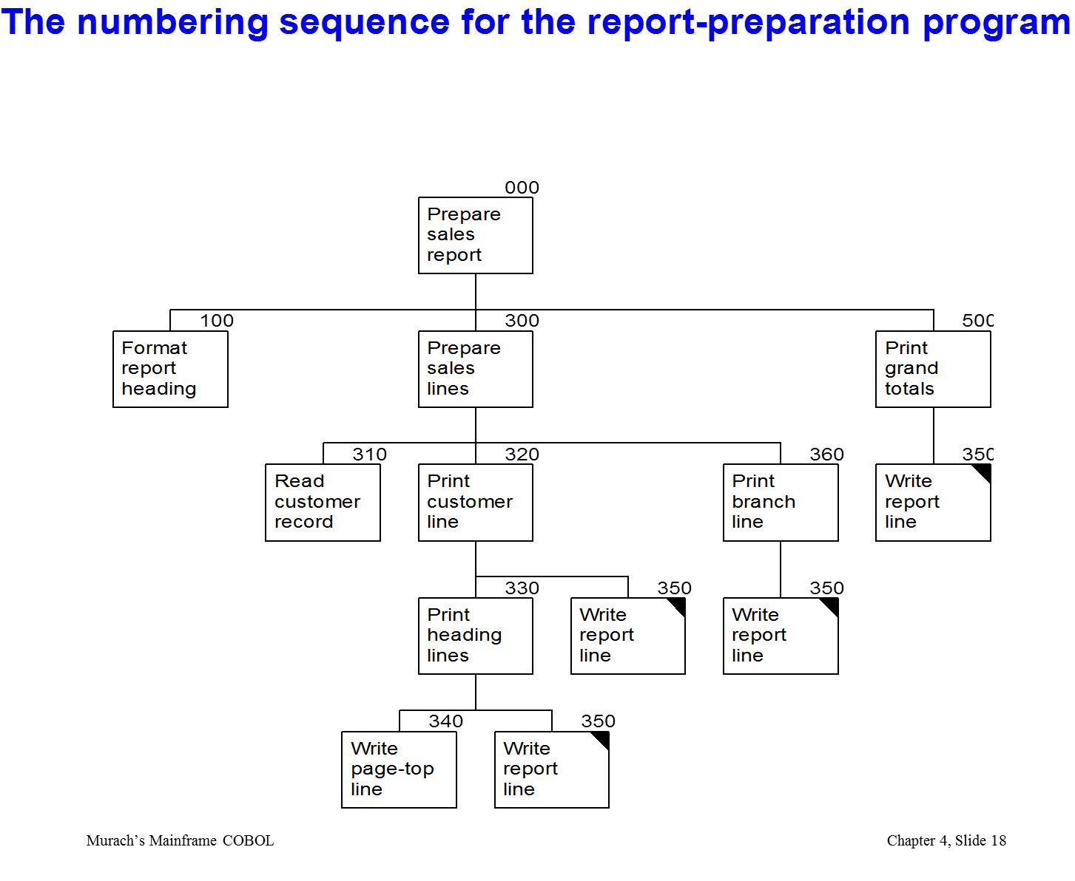
Transactions within a single program architecture

Slide 76
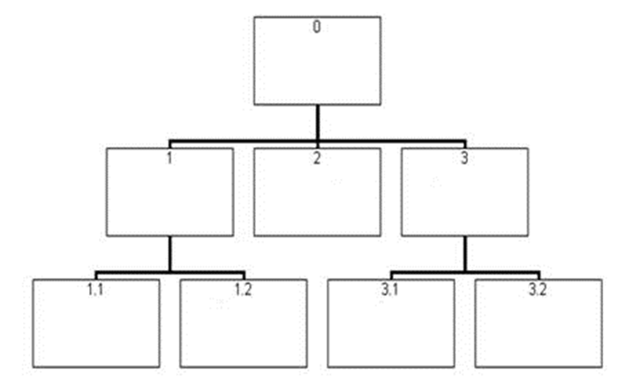

Slide 77
Transaction Dispatchers – Some Complexity
Comments:
  In a threaded environment, where many transactions may be ‘in process,’ data to be modified must be locked and released as appropriate. Additional complexity.
  Particularly complicated when an application needs to perform a query prior to an update transaction all the while ensuring that the data is not changed…
  See database books on the details. (record / attribute lockout)

Slide 78
Example of a Transaction-Processing System
At a higher level – the application architecture rather than a program architecture:
Handler for
Reservation
Transaction
transactions
Transaction
transaction
input
dispatcher
Handler for
Flight cancellation
transaction
Recognize that these ‘components’ might exist on a local device or remotely.
The ‘component’ may simply be an implementation of some design subsystem.

Slide 79
The Transaction-Processing Architecture And Design Principles (As Usual, These Are Very Good..)
  1. Divide and conquer: The transaction handlers are suitable system divisions that can be given to separate software engineers for detailed design and development.
  2. Increase cohesion: Transaction handlers are naturally cohesive units.
  A ‘hander’ accommodates only ‘that’ transaction.’
  3. Reduce coupling: Separating the dispatcher from the handlers clearly reduces coupling.
  7. Design for flexibility: One may readily add new transaction handlers to handle additional transactions.
  11. Design defensively: One may add assertion checking in each transaction handler and/or in the dispatcher.
  Note: several principles missing here too….Design Decisions!!

Slide 80
Others Architectures

Slide 81
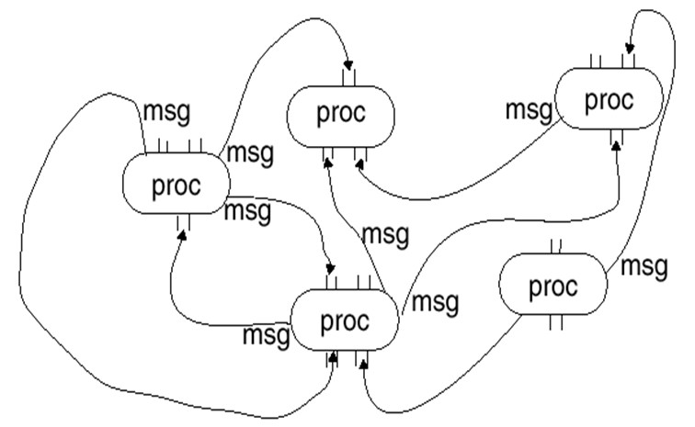
Other Styles - Process control
In process control model
  The system is divided into multiple independent processes
  The processes synchronously or asynchronously communicate with each other
  Communication linkages determine the topological nature of system

Slide 82
Other Styles - Process control
Advantage
  The decomposition of problem is straightforward
  The evolution and integration of system is easy
  Performance can be improved by parallelizing
Disadvantage
  The timing of communication is difOicult to control
  The cost of communication between processes is rather high

Slide 83
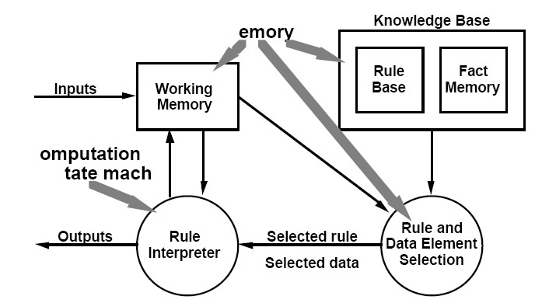
Other Styles - Rule-based Arch.
Ruled-­‐based architecture
  Encodes the knowledge of human experts into rules
  The rules are executed or activated when the speciOied conditions are satisfied

Slide 84
Rule-Based Style
Inference engine parses user input and determines whether it is a fact/rule or a query. If it is a fact/rule, it adds this entry to the knowledge base. Otherwise, it queries the knowledge base for applicable rules and attempts to resolve the query.

Slide 85
Rule-Based Style (cont’d)
Components: User interface, inference engine, knowledge base
Connectors: Components are tightly interconnected, with direct procedure calls and/or shared memory.
Data Elements: Facts and queries
Behavior of the application can be very easily modified through addition or deletion of rules from the knowledge base.
Caution: When a large number of rules are involved understanding the interactions between multiple rules affected by the same facts can become very difficult.

Slide 86
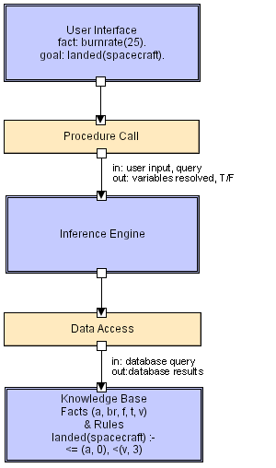
Rule Based LL

Slide 87
Heterogeneous Architectures
Focus on the real-world.

Slide 88
Heterogeneous architectures
No real system follows strictly only a single style
Styles themselves are not that strictly separated but they are blurred Architectures might be conceptually heterogeneous
N-tier architectures are layered architectures
N-tier architectures are typically data-centric architectures Thin clients involve some sort of notification architecture

Slide 89
Heterogeneous architectures
Architectures might be structurally heterogeneous Overall architecture follows one style
Single components follow other styles
The Web has a 2-tier architecture: browser and server
The browser itself has a notification architecture to handle user events

Slide 90
Heterogeneous architectures
Architectures might be heterogeneous at execution level At execution level components follow different styles
E.g. notification architectures might include remote procedure calls if components are distributed
Service architectures require networking architecture which is a layered architecture, etc..
In real systems architectures are heterogeneous at all levels!

Slide 91
Heterogeneous architectures
Web-based search engine
Conceptually: data-centric, layered, 3-tier
Structurally: layered (network), 3-tier, notification
Execution: distributed, service-oriented, notification with callbacks, ...

Slide 92
Example: Web search engine architecture
Crawlers: multiple and distributed
I.e. you have layered, service-oriented, notification
URLServer notifies and syncronizes crawlers that URLs to fetch
Web pages fetched and stored in storeserver
Storeserver: data-centric architecture
The searcher runs as a Web server

Slide 93
Conclusion
Architectural styles provide patterns
Why one should know these styles?
They provide a common vocabulary
They provide blueprints on how a system can be designed
They provide a well known structure and behaviour

Slide 94
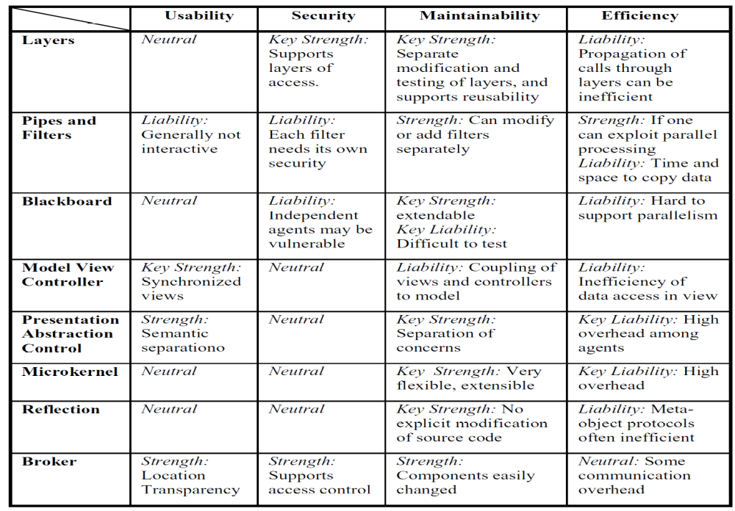
Table 1. Patterns’ Impact on Usability, Security, Maintainability and Efficiency

Slide 95
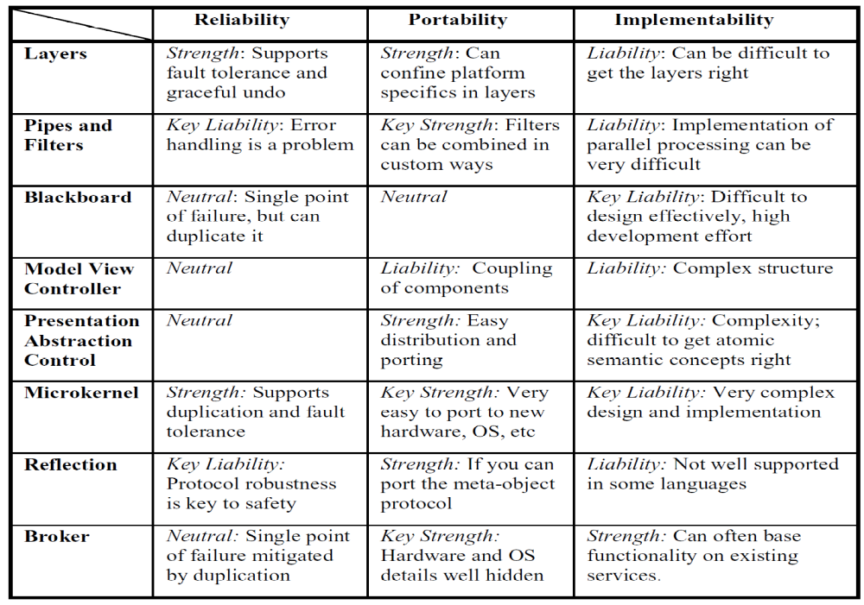
Table 2. Patterns’ Impact on Reliability, Portability, and Implementability

Slide 96
When There’s No Experience to Go On…
The first effort you should make in addressing a novel design challenge is to attempt to determine that it is genuinely a novel problem.
Basic Strategy
  Divergence – shake off inadequate prior approaches and discover/admit a variety of new ideas that offer a potentially workable solution
  Transformation – combine analysis and selection of these potential ides. New understanding and changes to the problem statement
  Convergence – select and further refine ideas
Repeatedly cycling through the basic steps until a feasible solution emerges.

Slide 97
Analogy Search
Examine other fields and disciplines unrelated to the target problem for approaches and ideas that are analogous to the problem.
Formulate a solution strategy based upon that analogy.
A common “unrelated domain” that has yielded a variety of solutions is nature, especially the biological sciences.
  E.g., neural networks

Slide 98
Brainstorming
Technique of rapidly generating a wide set of ideas and thoughts pertaining to a design problem
  without (initially) devoting effort to assessing the feasibility.
Brainstorming can be done by an individual or, more commonly, by a group.
Problem: A brainstorming session can generate a large number of ideas… all of which might be low-quality.
Chief value: identifying categories of possible designs, not any specific design solution suggested during a session.

Slide 99
“Literature” Search
Examining published information to identify material that can be used to guide or inspire designers
Digital library collections make searching much faster and more effective
  IEEE Xplore
  ACM Digital Library
  Google Scholar
The availability of free and open-source software adds special value to this technique.

Slide 100
Morphological Charts
The essential idea:
  identify all the primary functions to be performed by the desired system
  for each function identify a means of performing that function
  attempt to choose one means for each function such that the collection of means performs all the required functions in a compatible manner.
The technique does not demand that the functions be shown to be independent when starting out.
Sub-solutions to a given problem do not need to be compatible with all the sub-solutions to other functions in the beginning.

Slide 101
Removing Mental Blocks
If you can’t solve the problem, change the problem to one you can solve.
  If the new problem is “close enough” to what is needed, then closure is reached.
  If it is not close enough, the solution to the revised problem may suggest new venues for attacking the original.

Slide 102
Controlling the Design Strategy
Exploring diverse approaches
  Potentially chaotic
  be care in managing the activity
Identify and review *critical* decisions
Relate the costs of research and design to the penalty for taking wrong decisions
Insulate uncertain decisions
Continually re-evaluate system “requirements” in light of what the design exploration yields

